Slide 1
Why Fostering Good Business Ethics Is Important
Organizations have at least five good reasons to pursue CSR goals and to promote a work environment
To gain the goodwill of the community
To create an organization that operates consistently
To foster good business practices
To protect organization/employees from legal action
To avoid unfavorable publicity

Slide 2
Gaining the Goodwill of the Community
Organizations have fundamental responsibilities to society
Declared in formal statement of company’s principles or beliefs
Include:
Making contributions to charitable organizations and nonprofit institutions
Providing benefits for employees in excess of legal requirements
Choosing economic opportunities that might be more socially desirable than profitable

Slide 3
Examples of some of the CSR activities supported by major IT organizations
Dell Inc. has several initiatives aimed at reducing the amount of natural resources it takes to create and ship its products, cutting the amount of energy it takes its customers to use its products, and curbing the effects its products have on people and the planet.
Google agreed to invest more than $1.5 billion in renewable energy projects, such as large-scale wind farms and rooftop solar panels.
IBM created a program to train transitioning service members to become certified as advanced data analysts. The company also launched the P-TECH program to help students from low-income families finish high school and obtain associate degrees. Several graduates of the program have taken entrylevel jobs at IBM while continuing to work toward a four-year degree.20
Microsoft made $922 million in technology donations to more than 120,000 nonprofit organizations globally.
Oracle delivered nearly $5 billion in resources (with a focus on computer science education) to help 2.2 million students in 100 countries become college-and-career ready

Slide 4
Creating an Organization That Operates Consistently
Consistency ensures that employees:
Know what is expected of them
Can employ the organization’s values to help them in decision making
Consistency also means that shareholders, customers, suppliers, and community know what they can expect of the organization

Slide 5
Many companies share the following values:
Operate with honesty and integrity, staying true to organizational principles
Operate according to standards of ethical conduct, in words and action
Treat colleagues, customers, and consumers with respect
Strive to be the best at what matters to the company
Value diversity
Make decisions based on facts and principles

Slide 6
Fostering Good Business Practices
Good ethics means good business/improved profits
Companies that:
Produce safe and effective products
Avoid costly recalls and lawsuits
Provide excellent service that retains customers
Develop and maintain strong employee relations
Suffer lower turnover rates
Enjoy better employee morale

Slide 7
Suppliers/business partners place priority on working with companies that operate in a fair and ethical manner
Bad ethics means bad business/waning profits
Bad ethics can lead to bad business results
Bad ethics can have a negative impact on employees

Slide 8
Protecting the Organization and Its Employees from Legal Actions
U.S. Supreme Court established that an employer can be held responsible for the acts of its employees
This principle is called respondeat superior, or “let the master answer.”
Coalition of several legal organizations argues establishment of ethics and compliance programs should reduce criminal liability of organization
Others argue company officers should not be given light sentences if their ethics programs are ineffective

Slide 9
Avoiding Unfavorable Publicity
Public reputation of company strongly influences:
Value of its stock
How consumers regard products and services
Degree of oversight received from government
Amount of support and cooperation received
Organizations are motivated to build strong ethics programs to avoid negative publicity
Prominent ad buyers and marketers are angry with Facebook after finding out that the world’s largest online social network service greatly exaggerated the average viewing time of video ads on its platform.
It is a key metric used by advertisers in deciding how much to spend on Facebook video versus other video services such as YouTube, Twitter, and TV networks

Slide 10
Improving Corporate Ethics
A well-implemented ethics and compliance program and a strong ethical culture can, in turn, lead to less pressure on employees to misbehave and a decrease in observed misconduct
Ethics Resource Center defines the following Characteristics of a successful ethics program
Employees willing to seek advice about ethical issues
Employees feel prepared to handle situations that could lead to misconduct
Employees are rewarded for ethical behavior
Employees are not rewarded for success obtained through questionable means
Employees feel positive about their company

Slide 11
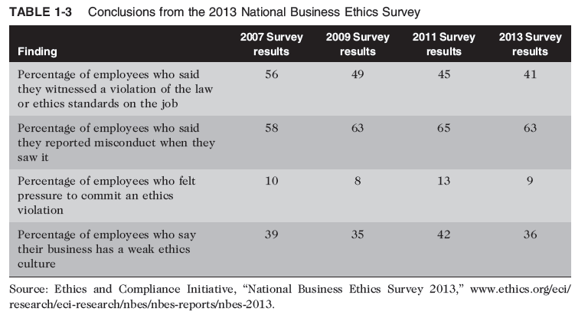
The 2013 National Business Ethics Survey found evidence of continuing improvement in ethics in the workplace, as summarized in Table 1-3.

Slide 12
The risk of unethical behavior is increasing, so improving business ethics is becoming more important for all companies.
The following sections explain some of the actions corporations can take to improve business ethics.

Slide 13
1. Appointing a Corporate Ethics Officer
Corporate ethics officer (also called a corporate compliance officer)
Provides vision and leadership in business conduct
Should be well-respected, senior-level manager (legal staff, human resources, finance, auditing, security, or line operations) who reports directly to the CEO
Ensures ethical procedures are put in place
Creates and maintains ethics culture
“Aligns the practices of a workplace with the stated ethics and beliefs of that workplace, holding people accountable to ethical standards”
Is responsible for key knowledge/contact person for ethical issues

Slide 14
2. Ethical Standards Set by Board of Directors
Board oversees the organization’s business activities and management
Board members of company are expected to:
Conduct themselves according to the highest standards of personal and professional integrity
Set standard for company-wide ethical conduct
Ensure compliance with laws and regulations
Create environment in which employees can seek advice about business conduct, raise issues, and report misconduct

Slide 15
3. Establishing a Corporate Code of Ethics
Code of Ethics
Highlights an organization’s key ethical issues and identifies the primary values and principles that are important to the organization and its decision making
frequently include a set of formal, written statements about the purpose of an organization, its values, and the principles that should guide its employees’ actions
applies to its directors, officers, and employees and focuses employees on areas of ethical risk
Offers guidance for employees to recognize and deal with ethical issues
Provides mechanisms to report unethical conduct
Help employees abide by the law, follow necessary regulations, and behave in an ethical manner

Slide 16
Establishing a Corporate Code of Ethics (cont’d.)
Cannot gain company-wide acceptance unless it is:
Developed with employee participation
Fully endorsed by organization’s leadership
Must continually be applied to company’s decision making and emphasized as part of its culture
Breaches in the code of ethics must be identified and dealt with appropriately
Each year, Corporate Responsibility magazine rates publicly held U.S. companies, using a statistical analysis of corporate ethical performance in several categories.
For 2016, the categories were environment, climate change, human rights, employee relations, corporate governance, philanthropy and community support, and financial performance

Slide 17
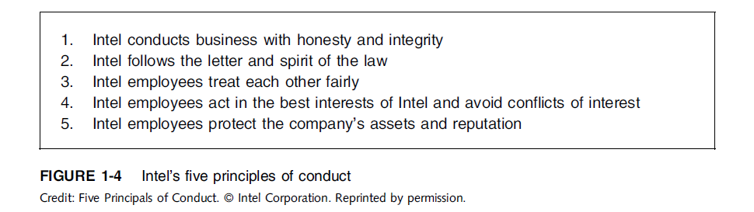
Establishing a Corporate Code of Ethics (cont’d.)
Intel Corporation, the world’s largest chip maker, has been ranked in the top 25 every year since the list began in 2000, and was ranked second in 2016
As such, Intel is recognized as one of the most ethical companies in the IT industry.
A summary of Intel’s code of ethics is provided below.

Slide 18
Establishing a Corporate Code of Ethics (cont’d.)
Sarbanes-Oxley Act of 2002
Legislated in response to public outrage over several major accounting scandals
Section 404 requires that the CEO and CFO sign any SEC filing to attest to its accuracy
Section 406 requires public companies to disclose whether or not they have a code of ethics and if any waivers to that code have been granted

Slide 19
4. Conducting Social Audits
Social audit
Reviews how well organization is meeting ethical and social responsibility goals
Communicates new goals for upcoming year
Shared broadly with employees, shareholders, investors, market analysts, customers, suppliers, government agencies, and local communities

Slide 20
5. Requiring Employees to Take Ethics Training
Personal convictions improved through education
Comprehensive ethics education program encourages employees to act responsibly and ethically
Often presented in small workshop formats
Employees apply code of ethics to hypothetical but realistic case studies
Demonstration of recent company decisions based on principles from the code of ethics

Slide 21
Requiring Employees to Take Ethics Training (cont’d.)
Critical that training increase the percentage of employees who report incidents of misconduct
Employees must:
Learn effective ways of reporting incidents
Be reassured their feedback will be acted on without retaliation (without fear of loosing Job)

Slide 22
6. Including Ethical Criteria in Employee Appraisals
Only 43% of companies include ethical conduct in employee’s performance appraisal
Ethical criteria include:
Treating others fairly and with respect
Operating effectively in a multicultural environment
Accepting personal accountability
Continually developing themselves and others
Operating openly and honestly with all

Slide 23
7. Creating an Ethical Work Environment
Sometimes good employees may make bad ethical choices
In highly competitive workplaces often employees may be encouraged to do “whatever it takes” to get the job done
Employees need a knowledgeable resource to discuss perceived unethical practices i.e., Intel has
A manager
Legal or Internal Audit Department
Business Unit’s legal counsel
Anonymously through internal Web site

Slide 24
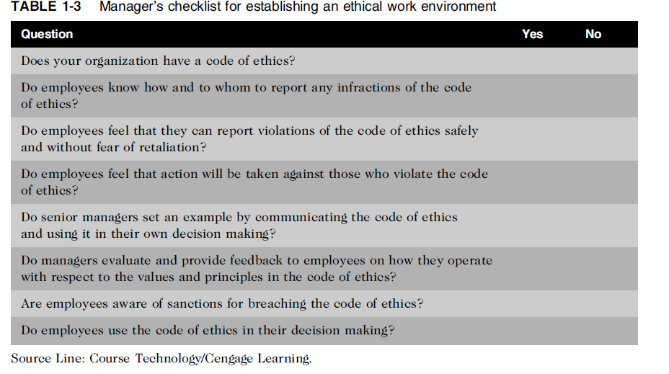
Creating an Ethical Work Environment (cont’d.)

Slide 25
Including Ethical Considerations in Decision Making
Steps in a decision-making process
Develop problem statement
Identify alternatives
Evaluate and choose alternative
Implement decision
Evaluate results
Success

Slide 26
Develop a Problem Statement
Clear, concise description of the issue
Answers these questions:
What causes people to think there is a problem?
Who is directly affected by the problem?
Is there anyone else affected?
How often does it occur?
What is the impact of the problem?
How serious is the problem?
Most critical step in decision-making process

Slide 27
Develop a Problem Statement (cont’d.)
Example of a good problem statement:
“Our product supply organization is continually running out of stock of finished products, creating an out-of-stock situation on over 15 percent of our customer orders, resulting in over $300,000 in lost sales per month.”
Examples of poor problem statements:
“We need to implement a new inventory control system.” (possible solution, not a problem statement)
“We have a problem with finished product inventory.” (not specific enough)

Slide 28
Identify, Evaluate, and Choose an Alternative
Enlist help to brainstorm alternative solutions
Evaluate by weighing laws, guidelines, and principles
Consider likely consequences of each alternative
Alternative selected must:
Be ethically and legally defensible
Be consistent with policies and code of ethics
Take into account impact on others
Provide a good solution to problem

Slide 29
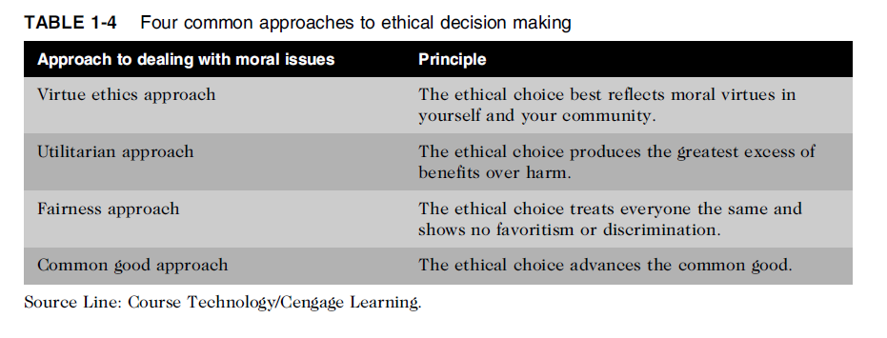
Common Approaches to Ethical Decision Making
Table 1-5 Four common approaches to ethical decision making

Slide 30
Virtue Ethics Approach
Virtue ethics approach
Focuses on concern with daily life in a community
People guided by virtues to reach “right” decision
More effective than following set of principles/rules
Problems
Does not provide guide for action
Virtue cannot be worked out objectively; depends on circumstances

Slide 31
Utilitarian Approach
Utilitarian approach
Chooses action that has best overall consequences
Finds the greatest good by balancing all interests
Fits concept of value in economics and the use of cost-benefit analysis
Problems
Measuring and comparing values is often difficult
Predicting resulting benefits and harm is difficult

Slide 32
Fairness Approach
Fairness approach
Focuses on fair distribution of benefits/burdens
Guiding principle is to treat all people the same
Problems
Decisions can be influenced by personal bias
Others may consider the decision unfair

Slide 33
Common Good Approach
Common good approach
Work together for common set of values and goals
Implement systems that benefit all people
Problems
Consensus is difficult
Some required to bear greater costs than others

Slide 34
Implement the Decision and Evaluate the Results
Implement the decision
Efficient, effective, timely implementation
Communication is key for people to accept change
Transition plan made easy and pain-free
Evaluate the results
Monitor results for desired effect
Observe impact on organization and stakeholders
Return to “Develop problem statement” step if further refinements may be needed

Slide 35
Ethics in Information Technology
The growth of the Internet and social networks; the ability to capture, store, and analyze vast amounts of personal data; and a greater reliance on information systems in all aspects of life have increased the risk that information technology will be used unethically
Public concern about the ethical use of information technology includes:
E-mail and Internet access monitoring
Downloading in violation of copyright laws (i.e., music/movies)
Unsolicited e-mail (spam)
Hackers and identify theft
Students and plagiarism
Cookies and spyware

Slide 36
Ethics in Information Technology (cont’d.)
The general public does not understand the critical importance of ethics as applied to IT
Important decisions are often left to technical experts
General business managers must assume greater responsibility for these decisions by:
Making decisions based on technical knowledge, business know-how, and a sense of ethics
Creating an environment where ethical dilemmas can be discussed openly, objectively, and constructively

Slide 37
Ethics in Information Technology (cont’d.)
Goals of this text
To educate people about the tremendous impact of ethical issues in the successful and secure use of information technology
To motivate people to recognize these issues when making business decisions
To provide tools, approaches, and useful insights for making ethical decisions

